Slide 1
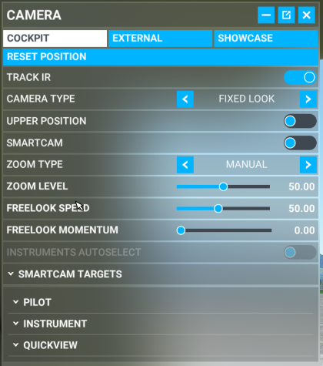
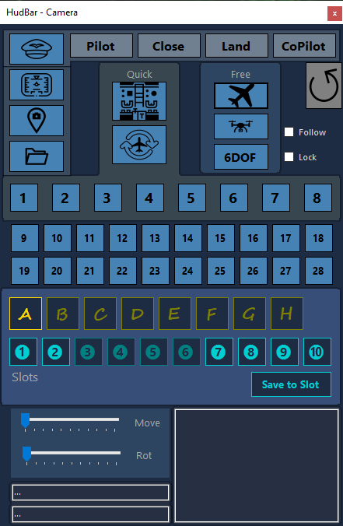
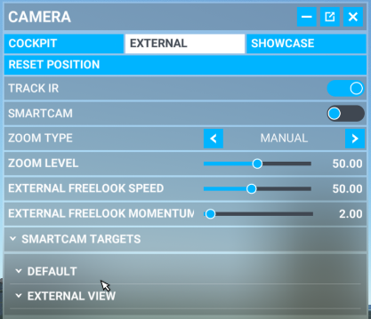
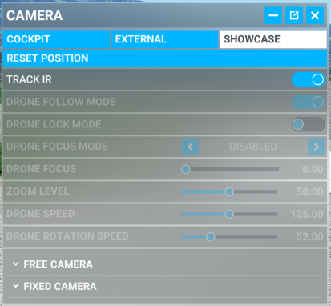
SmartCam

Slide 2
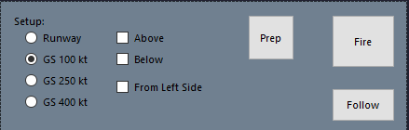
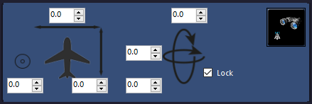
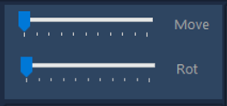
BASE
DRONE
6DOF
ZOOM
ZOOM

Slide 3
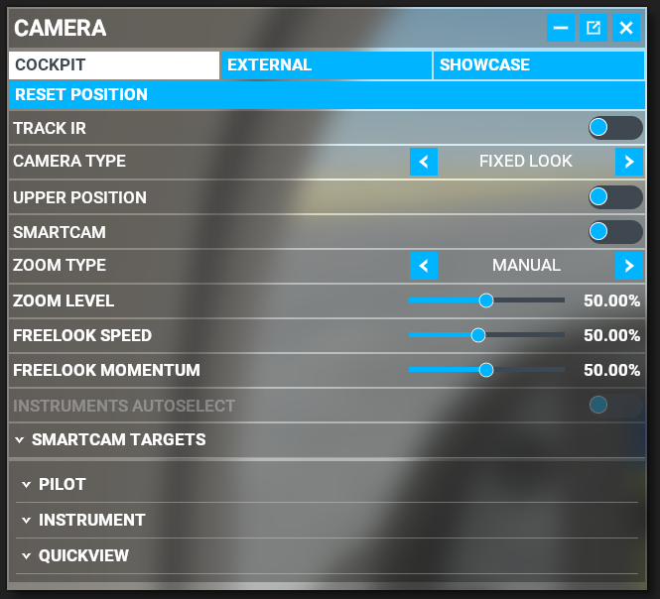
State
SubState
ViewType
Cockpit
External
Drone
Drone Plane
Ground
ShowCase
Locked
Unlocked
QuickView
Smart
Instrument
Default
Pilot
Instrument
Quick
External
Other

Slide 4
NAV1
KASDJS (VOR)
GPS
KASDJS (VOR)
123.22
123.22
123.22
123.22
NAV1
123.22
123.22
Đ KASDJS (VOR)
DIS DTK BRG
DIS DTK BRG
NAV2
123.22
123.22
KASDJS (VOR)
_.__ ___ ___
_.__ ___ ___
DME
123.22
123.22
0.0 ___ __:__
0.0 ___ __:__
ADF1
123.22
123.22
ADF2
123.22
123.22
GS TRK ETE
GS TRK ETE
COM1
123.22
123.22
COM2
123.22
123.22
. . . . . ^ . . . . .
X
. . . . . ^ . . . . .
. . . . . ^ . . . . .
X
X
Tx off
7700
FROM

Slide 5
TOP
BAR
WINDOW
R
I
G
H
T
L
E
F
T
WINDOW NO BORDER
TILE
BOTTOM

Slide 6
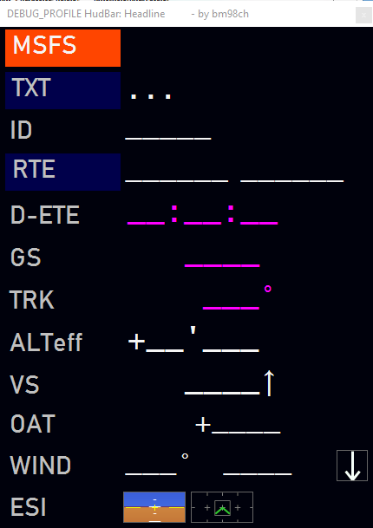
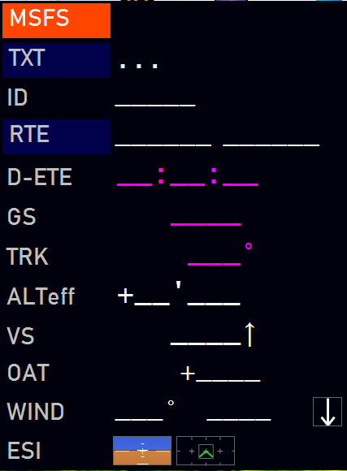
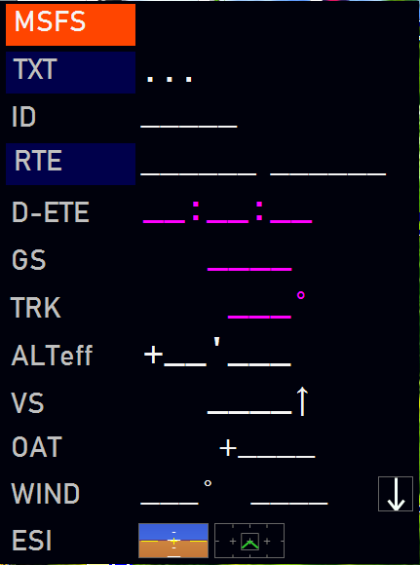
TOP
Bar - Top
R
I
G
H
T
L
E
F
T
Window – Left/Right
Tile - Left
Window no border – Left/Right
Tile - Bottom
BOTTOM

Slide 7
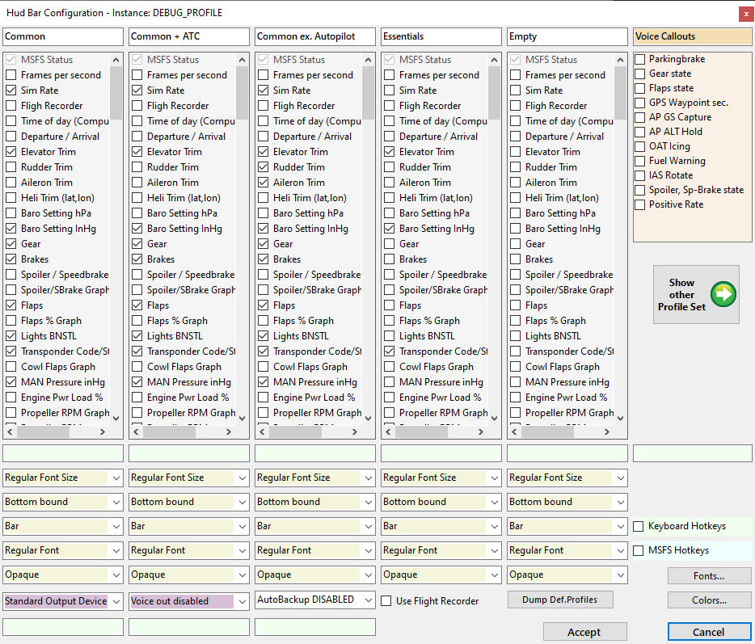
Tab
Callouts
Hotkeys
Keyboard
MSFS
HK ShowHide
HK FlightBag
HK CamCtrl
HK Checklist
FontSize
Condensed
Opacity
Bar
Top bound
Hotkey
BackgroundFile
…
Output Device
Backup
Fonts…
Voice
Recorder
Colors…
Accept
Cancel

Slide 8
-10
-8
-5
-2
0
2
5
8
10
-10
-8
-5
-2
0
2
5
8
10

Slide 9
-10
-5
0
5
10
-10
-5
0
5
10

Slide 10
-10
-5
0
5
10
-10
-5
0
5
10

Slide 11
-10
-5
0
5
10
-10
Ellipse (-3,-9, 6,13)
Line (2p, -6,-10,6,3)
Line (2p, 6,-10,-6,3)
Pt(-1,3)
Pt(-1,7)
Pt(-5,9)
Pt(-4,10)
Pt(0,9)
Pt(4,10)
Pt(5,9)
Pt(1,7)
Pt(1,3)
-5
0
5
10

